Slide 1

Cloud based Name card App
Tejaswi Ayyadapu
Rahul Reddy Yerva

Slide 2
Motivation
•Our project motivation is about sharing ones details with other through a simple QR code.
•We can be able to share some limited information like mobile number, email, LinkedInn profile etc.

Slide 3
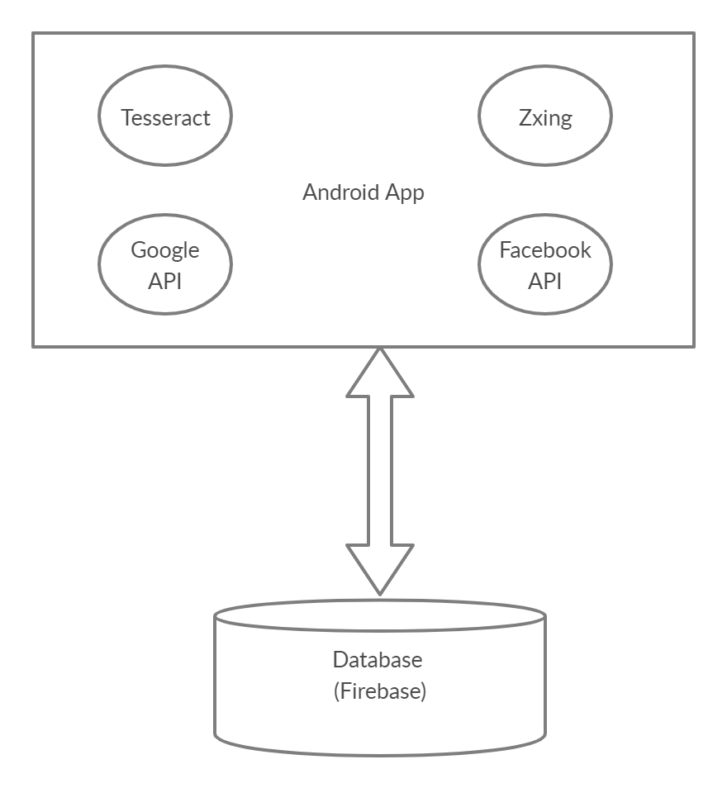
System Architecture

Slide 4
Implementation Environment
Android Studio
Firebase

Slide 5
Modules list
Login.
Home.
User details.
Scan & Generate QR.
OCR.

Slide 6
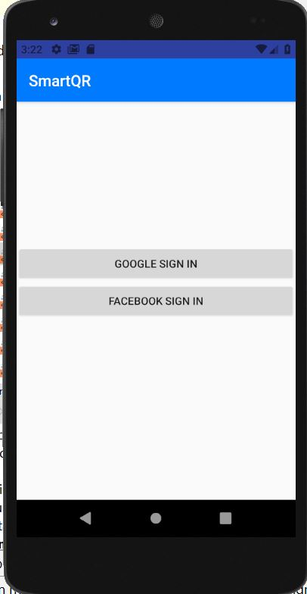
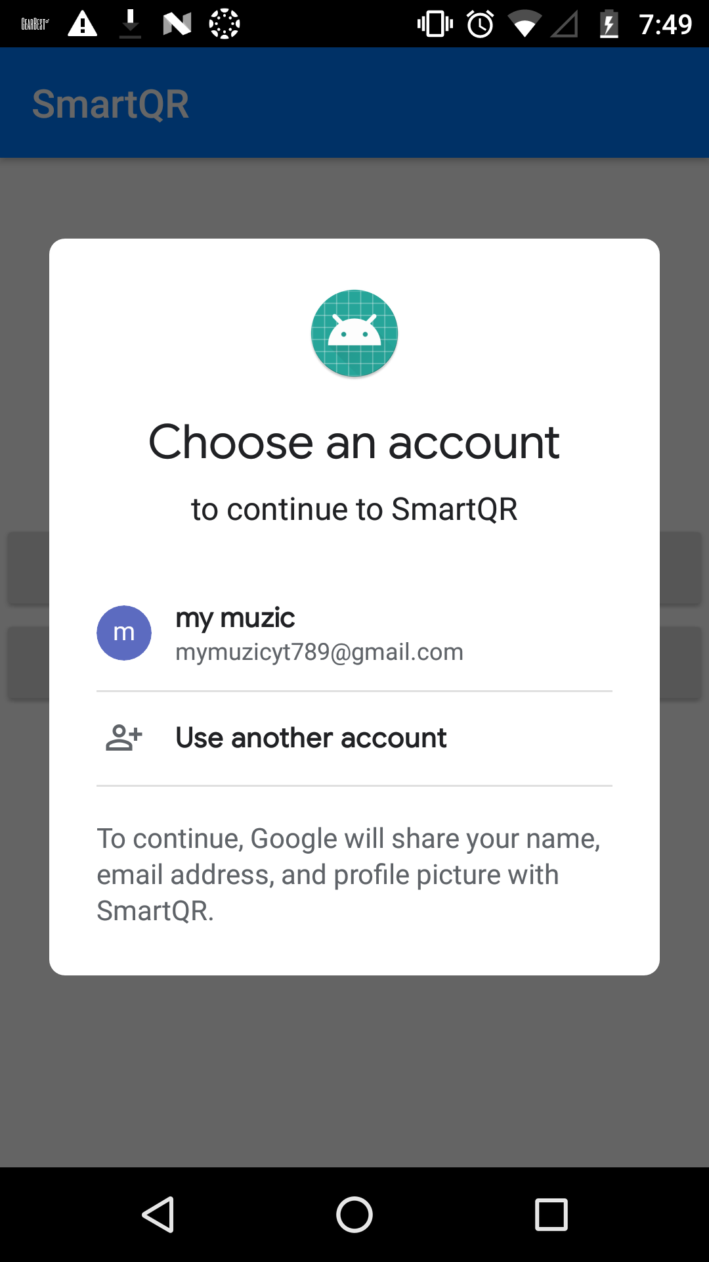
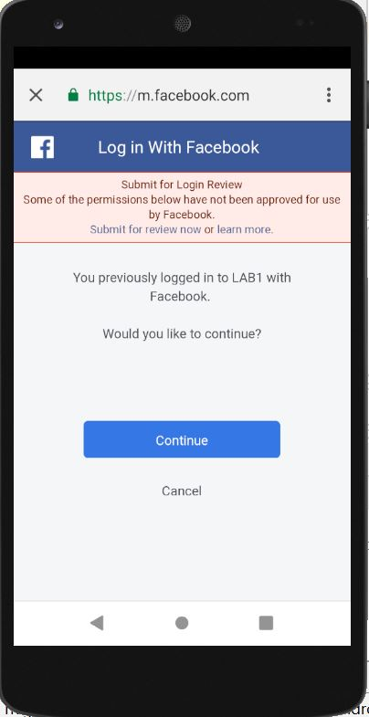
Login Page

Slide 7
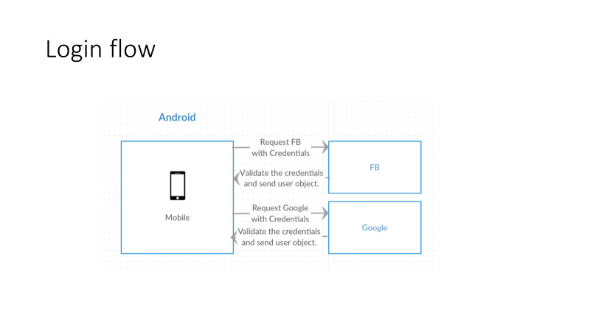

Slide 8
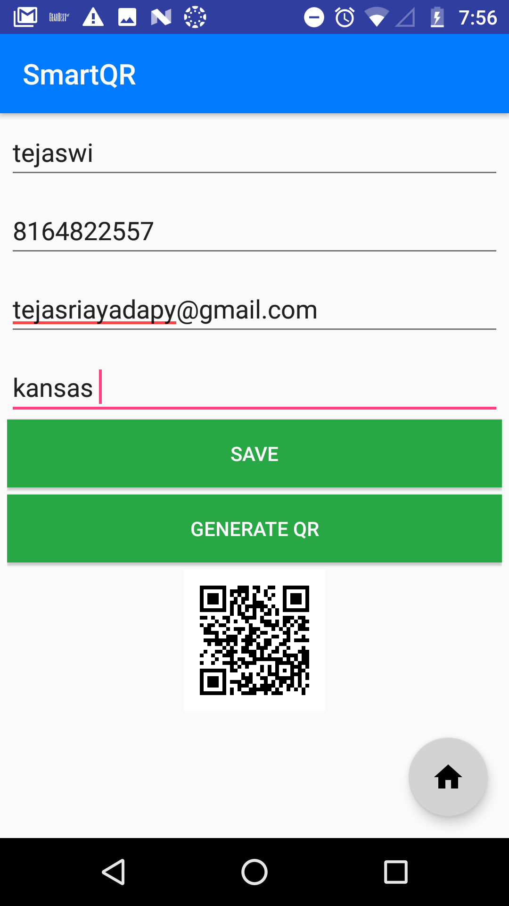
USER DETAILS PAGE

Slide 9
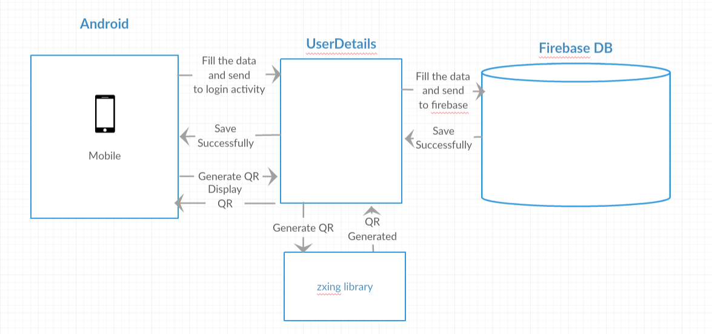
USER DETAILS FLOW

Slide 10
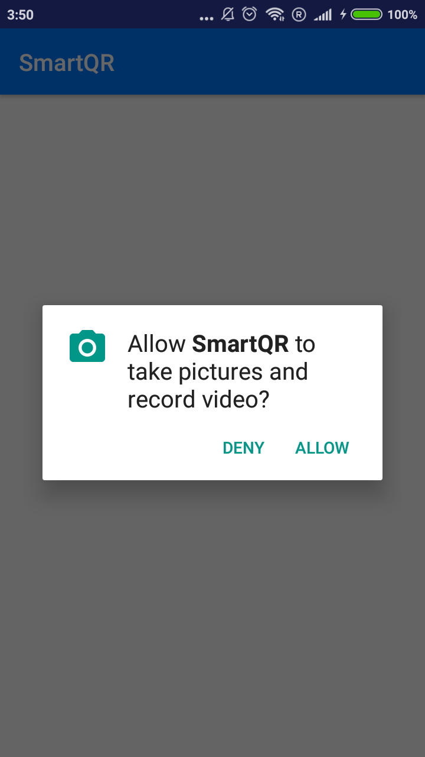
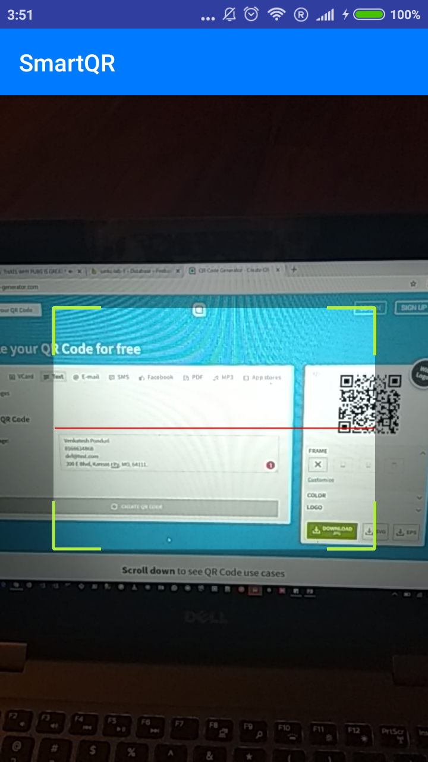
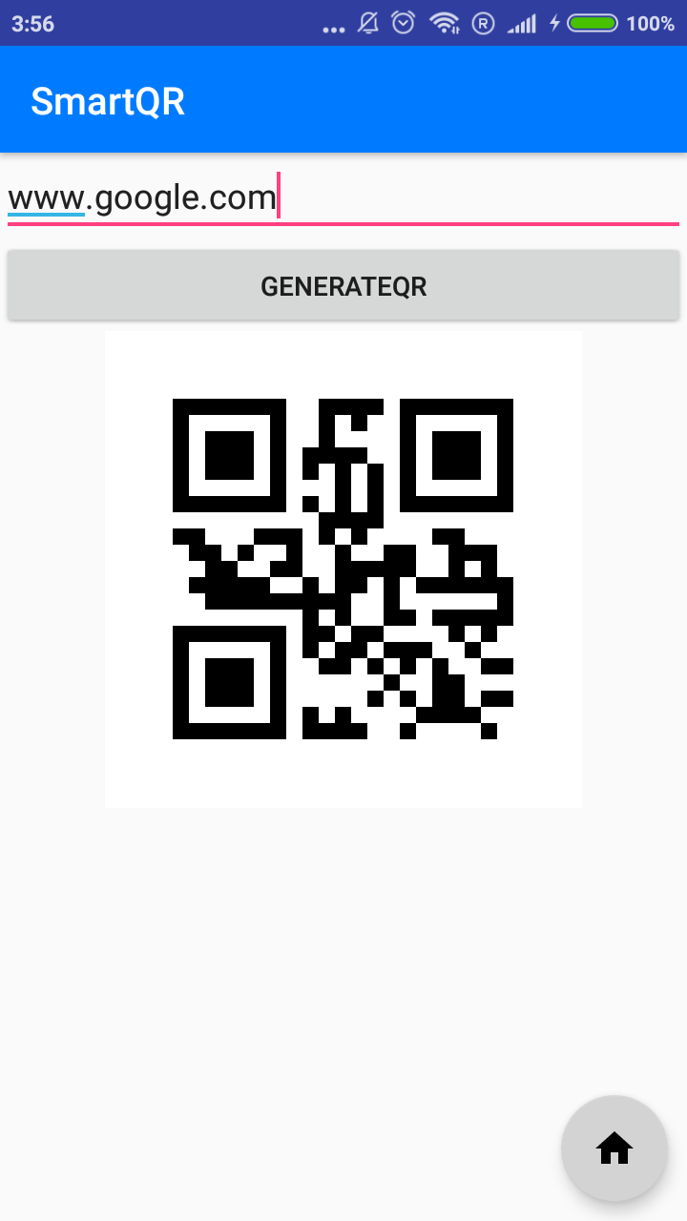
Scan & Generate QR.

Slide 11
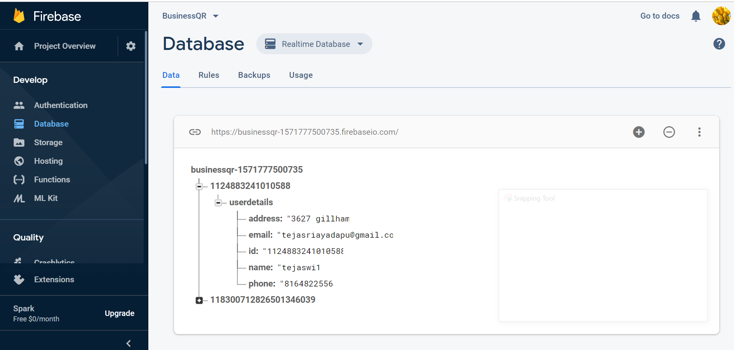
Firebase snapshot

Slide 12
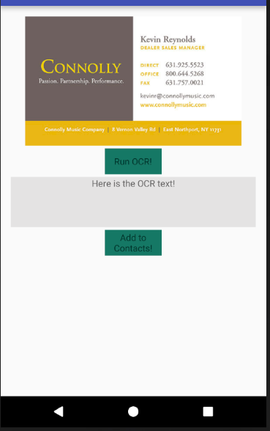
OCR using tesseract

Slide 13
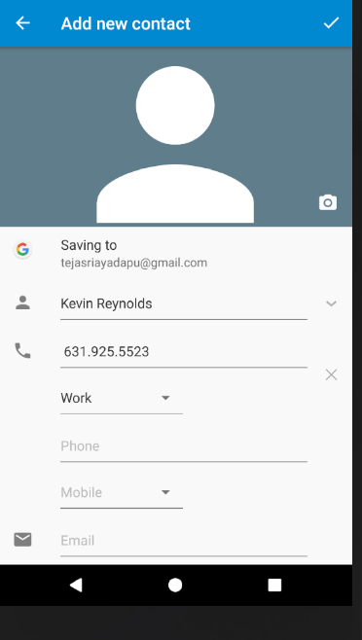
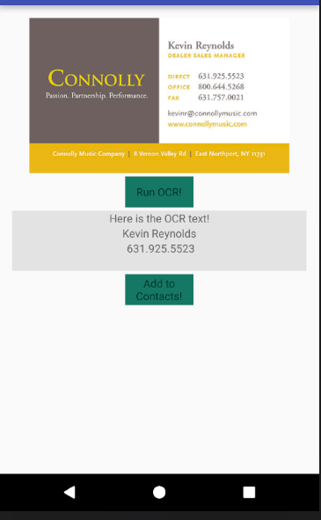
Adding to contacts automatically

Slide 14
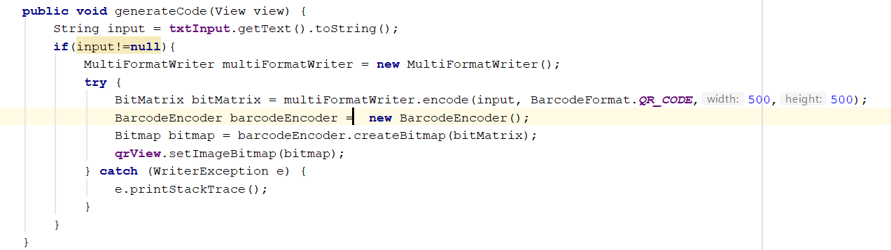
Using Zxing library

Slide 15
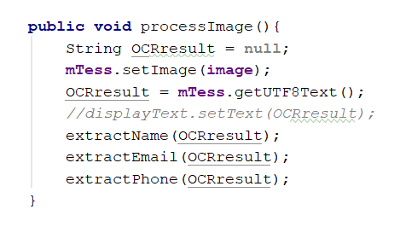
Tesseract library usage

Slide 16
Link for demo
https://drive.google.com/open?id=1W4-20BOTiR8g2cmE2dNCVInrkDkUmYXS

Slide 17
Challenges Faced
OCR
QR Code Scanner
Facebook login

Slide 18
Approaches
We have OCR engine using Tesseract library
Initially we found some issue with the facebook API, but later we have realized that facebook has changed their way of accessing the API ,so we have corrected that in an appropriate way.
We have used Zxing library for QR scanning

Slide 19
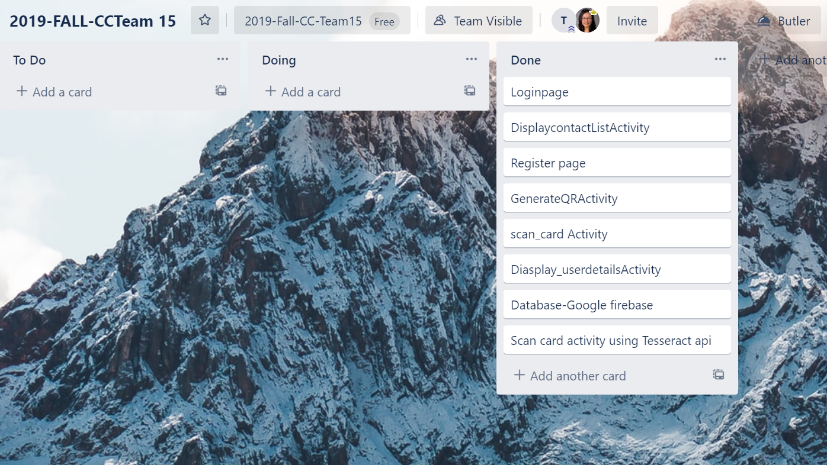
Trello Dashboard
As a team we have contributed equally for the project

Slide 20
Questions ?

Slide 21
Thank you.

